Slide 1
DIGITAL WORLD OF WORK
LABOUR RELATIONSHIPS IN A DIGITAL WORLD

Slide 2
DIGITAL WORLD OF WORK
THE INDUSTRIAL REVOLUTIONS MADE A LOT OF CHANGES IN LABOUR RELATIONSHIPS AND IN THE WORLD AS IT WAS KNOWN.
FROM THE FIRST INDUSTRIAL REVOLUTION TO THE DIGITAL REVOLUTION A LONG PATH HAS BEEN MADE IN A VERY SHORT TIME.

Slide 3
DIGITAL WORLD OF WORK
THE 1ST INDUSTRIAL REVOLUTION STARTED IN ENGLAND IN THE SECOND HALF OF THE XVIII CENTURY UPON THE INVENTION OF THE STEAM MACHINE.
IT WAS THE CORK AND STEAM REVOLUTION.
UNSKILLED WORKERS, THE LARGE MAJORITY, BECAME EMPLOYEES WHILE THE MORE SKILLED WERE PAID BY OUTPUT OR PIECEWORK.
IT WAS THE BASIS OF MARXISM.

Slide 4
DIGITAL WORLD OF WORK
THE 2ND INDUSTRIAL REVOLUTION HAPPENED WITH THE INDUSTRIAL DEVELOPMENT OF THE POST-WAR.
IT WAS THE TIME FOR THE METAL, METALLURGY AND CHEMICAL INDUSTRIES.
NEW METHODS: SERIAL PRODUCTION, NONE OR FEW INOVATION ON WORKING PRACTICES.
VERTICALISATION OF WORKING RELATIONSHIPS – FORDISM AND TAYLORISM
UNSKILLED WORKERS WITH MECHANICAL FUNCTIONS.

Slide 5
DIGITAL WORLD OF WORK
THE 4TH INDUSTRIAL REVOLUTION, IF WE CONSIDER THE 3RD AS THE MEDIA REVOLUTION, STARTED AFTER THE SEVENTIES LAST CENTURY AND IS STILL ON GOING.
IT´S THE DIGITAL REVOLUTION.
DEMAND FOR TECHNOLOGY AND SPECIALIZED LABOUR FORCE.
COMPUTARIZATION, BIOTECHNOLOGY, MICROELECTRONICS, INFORMATICS MAKE PRODUCTION MORE FLEXIBLE AND IMPROVE EFFICIENCY.
THE WORLD IS JUST A “CLICK AWAY”
GIANT STEPS HAVEN BEEN TAKEN TOWARDS GLOBALISATION

Slide 6
DIGITAL WORLD OF WORK
CHALLENGES
NONE EUROPEAN COUNTRY IS ABLE TO SUCCED ALONE ON THE DIGITAL WORLD
USA AND CHINA ARE THE SCALE EUROPE NEEDS TO BE COMPARE TO
A COMMON STRATEGY IS NEEDED
A RELIABLE AND PREDICTABLE ENVIRONMENT IS VITAL
COOPERATION BETWEEN MEMBER STATES IS THE KEY
THE DIFFERENCES ON INDUSTRIAL PRODUCTION AND TECHNOLOGICAL DEVELOPMENT BETWEEN MEMBER STATES ARE CAUSE FOR CONCERN

Slide 7
DIGITAL WORLD OF WORK
CHALLENGES IN THE LABOUR MARKET
DIGITAL ECONOMY AFFECTS ALL THE PROFESSIONS IN LABOUR MARKET
CHANGES ON JOB DESCRIPTION, SKILLS AND QUALIFICATIONS, EDUCATION AND TRAINING, WORK ENVIRONMENT AND PROCESS ORGANIZATION, CONTRACTUAL RELATIONSHIPS, WORK METHODS, CAREER PLANNING, ARE THERE
HOW TO DEAL WITH A TECHNOLOGY THAT IS LEADING BUT CAN LEAVE A LOT OF PEOPLE BEHIND
SKILLS MUST BE IMPROVED TO ENSURE THAT INDIVIDUALS ARE ABLE TO ADAPT AND TO MEET THE NEEDS OF INTERNACIONAL MOBILITY
PROMOTE PUBLIC AND PRIVATE INVESTMENT ON VOCATIONAL EDUCATION AND TRAINING
DIGITALISATION LEADS TO THE DISMISSAL OF A LARGE NUMBER OF WORKERS, AFFECTING HARDLY THE MIDDLE CLASS AND THE ELDERS

Slide 8
DIGITAL WORLD OF WORK
WHAT CAN WE DO?
FIRST OF ALL WE MUST REALISE THAT DIGITAL WORLD IS HERE TO STAY

Slide 9
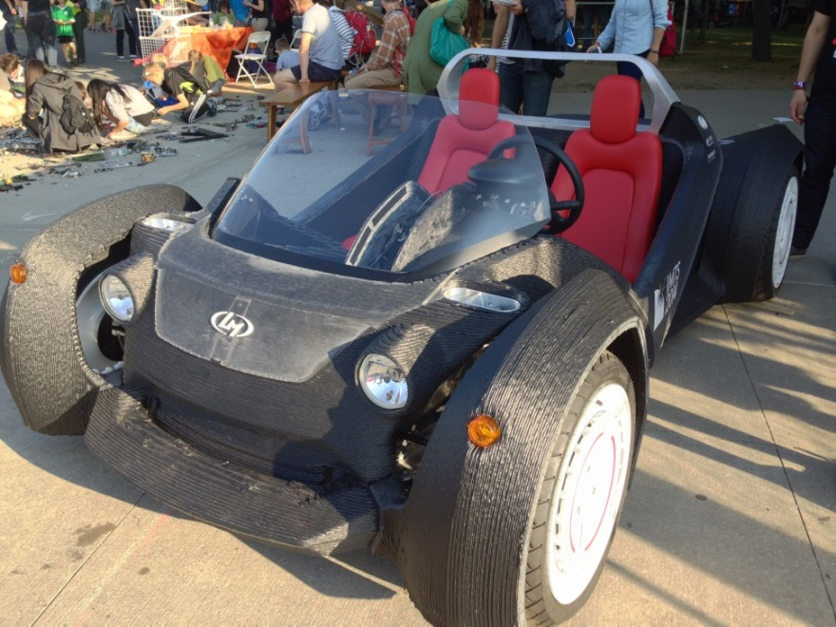
DIGITAL WORLD OF WORK
LOCAL MOTORS PRODUCED THIS CAR – STRATI – THROUGH A CROUNDSOURCING PLATFORM FOR THE DESIGN PROJECTS AND THE ALL CAR WAS 3D PRINTED

Slide 10
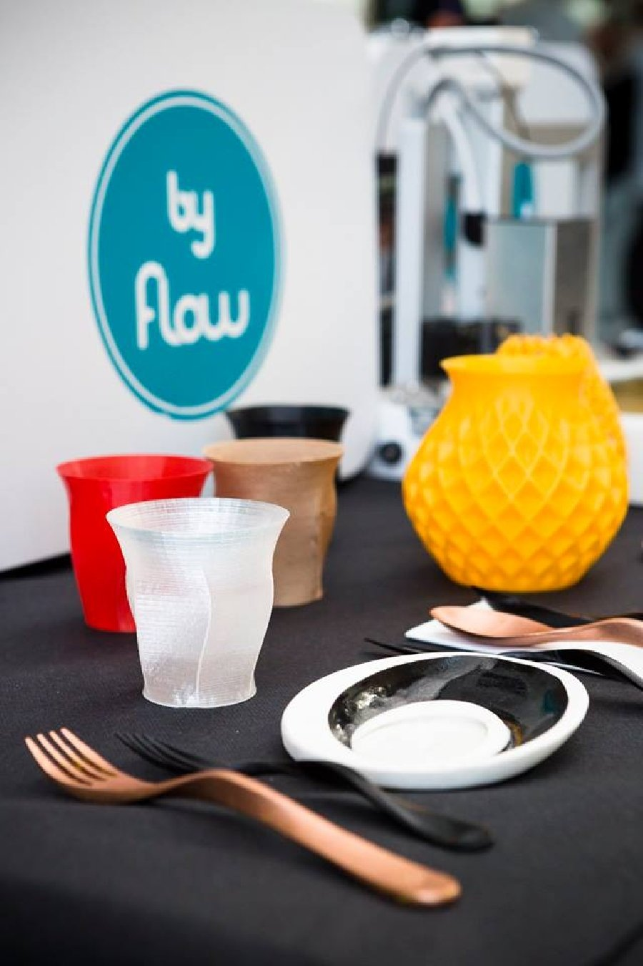
DIGITAL WORLD OF WORK
ALSO THIS OBJECTS WERE 3D PRINTED

Slide 11
DIGITAL WORLD OF WORK
DIGITALISATION OPENS OPPORTUNITIES AND MORE OPTIONS TO SELF RESPONSABILITY
AND PERSONAL FREEDOM ON WORK SCHEDULE AND WORKPLACE
IT ALSO OPENS BUSINESS OPPORTUNITIES
YOUNG PEOPLE ARE INOVATING AND BECOMING ENTREPRENEURS
NEW FORMS OF WORK APPEAR IN THE GREY LINE BETWEEN EMPLOYED WORK AND FREELANCE WORK

Slide 12
DIGITAL WORLD OF WORK
WE MUST INSURE:
SOCIAL RELATIONSHIPS STABLE
SOCIAL COHESION
BETTER SKILLS FOR BETTER JOBS
QUALIFIED WORKFORCE
DECENT WORK
FAIR INCOME

Slide 13
DIGITAL WORLD OF WORK
WE MUST ALSO CORRECT THE IMBALANCES OF THE LABOUR MARKET
AND RECONVERT THE PROFESSIONALS BY PROMOTING THEIR SKILLS
A LOT OF PROFESSIONS END BUT MUCH MORE ARE CREATED
ON AN EUROPEAN LEVEL THERE ARE HUNDRED OF THOUSANDS OF JOB VACANCIES ON ICT/IT AND TECHNICAL SECTORS, WHICH REQUIRE A PROPER COMMUNICATION

Slide 14
DIGITAL WORLD OF WORK
THE PORTUGUESE CASE
PORTUGAL IS COMMITED WITH THIS DIGITAL REVOLUTION
DIGITAL ECONOMY IS PROFUSELY MENTIONED IN ALL THE OPERATIONAL PROGRAMMES
THE STARTUP’S CREATION IS BOOMING
THERE IS AN AIM TO IMPROVE THE DIGITALISATION PROCEDURE OF THE SME’S WHICH ARE THE OVERWHELMING MAJORITY OF THE ENTREPRISES IN PORTUGAL
AND TO DINAMIZE THE TECHNOLOGY-BASED ENTREPRENEURSHIP
EMPLOYMENT OF ICT SPECIALISTS GROWS MORE THAN 4% PER YEAR SINCE 2000, SEVEN TIMES MORE THAN THE TOTAL EMPLOYMENT IN THE SAME PERIOD
PORTUGUESE PUBLIC ADMINISTRATION MADE A LOT OF EFFORTS TO DEVELOP AND DEPLOY SERVICES ONLINE FOR ENTREPRISES AND CITIZENS WITH SUCCESS. 41% OF INTERNET USERS EXCHANGE FILLES WITH PUBLIC ADMINISTRATION.

Slide 15
DIGITAL WORLD OF WORK
NEVERTHELESS PORTUGAL FACES A LOT OF CONSTRAINTS
THE WEAKER AREA IS HUMAN CAPITAL. PORTUGAL RANKS 20TH IN HUMAN CAPITAL AMONG EU COUNTRIES (DESI 2016)
ALTHOUGH THE NUMBER OF GRADUATES IN SCIENCES, TECHNOLOGIES AND MATHS IS HIGH, WE HAVE A PROBLEM ON INTERNET USERS, DIGITAL SKILLS AND ICT SPECIALISTS WHOSE NUMBERS ARE VERY LOW
65% OF PORTUGUESE USE INTERNET WEELKY (78% IN EU)
25% OF PORTUGUESE NEVER USED INTERNET (16% IN EU)
48% OF PORTUGUESE DON’T HAVE BASIC DIGITAL COMPETENCIES
ICT/IT SPECIALISTS REPRESENT 2,5% OF EMPLOYED PERSONS, IN SPITE OF THE GROWTH

Slide 16
DIGITAL WORLD OF WORK
HOWEVER:
PORTUGAL SCORES FAIRLY WELL IN INTEGRATING DIGITAL TECHNOLOGIES IN THE BUSINESS SECTOR, RANKING 9TH AMONG EU COUNTRIES, SPECIALLY
IN E-COMMERCE
AND RANKS 8TH AMONG EU COUNTRIES IN DIGITAL PUBLIC SERVICES

Slide 17
DIGITAL WORLD OF WORK
CONCLUSIONS

Slide 18
DIGITAL WORLD OF WORK
DIGITAL ECONOMY WILL CHANGE PEOPLE LIFES, MAINLY YOUNG GENERATIONS ONES
PEOPLE BELIEVES THAT JOBS WILL BE BETHER AND PROFESSIONAL OPPORTUNITIES WILL BE MORE
DIGITAL TECHNOLOGY WILL BE ABLE TO CHANGE THE WORLD, BOTH PERSONAL AND PROFESSIONAL, ALLOWING MORE FLEXIBILITY IN WORK AND MORE SELLECTION IN THE WAY WE WORK
ORGANIZATIONS MUST BE DIGITAL FACILITATORS, ENSURING TO THEIR STAFF THAT THEIR LIFES WILL BE BETTER, BECAUSE THE FIRM IMPLEMENTED THE RIGHT TECHNOLOGIES

Slide 19
DIGITAL WORLD OF WORK
FOR THE WORKERS DIGITAL WORLD CAN BRING
MORE JOB OPPORTUNITIES
MORE SELF SELLECTION
MORE FLEXIBILITY OF WORK SCHEDULE AND WORKPLACE

Slide 20
DIGITAL WORLD OF WORK
FOR THE EMPLOYERS
COSTS REDUCTION
MORE FLEXIBILITY IN HIRING
MORE AND BETTER MARKET FOR THEIR GOODS

Slide 21
DIGITAL WORLD OF WORK
BUT WE ALL, WORKERS (UNIONS INCLUDED) AND ENTREPRENEURS, FACE THE SAME CHALLENGES
EDUCATION AND TRAINING TO IMPROVE SKILLS AND ALLOW RECONVERTION
A MOTIVATED AND QUALIFIED WORK FORCE, DECENT JOBS AND FAIR INCOME IS EVERYBODY INTEREST
A BAD MANAGEMENT OF TENSIONS BETWEEN EMPLOYEES AND EMPLOYERS CAN BRING UP PUBLIC OPINION RESISTENCE

Slide 22
DIGITAL WORLD OF WORK
SO, IT’S ABSOLUTELY ESSENCIAL
SOCIAL DIALOGUE TO ALL LEVELS:
EUROPEAN
NATIONAL
REGIONAL
SECTORIAL
CORPORATE

Slide 23
DIGITAL WORLD OF WORK
SOCIAL AND ECONOMIC ENVIRONMENT, AS WELL AS TRADITIONS AND CULTURE ARE DIFFERENT FROM COUNTRY TO COUNTRY
WHERE FORE EVERYBODY MUST PLAY ITS ROLE AND ASSUME A JOINT RESPONSABILITY.

Slide 24
DIGITAL WORLD OF WORK
THANK YOU!

